Slide 1
Aerothermochemistry and Combustion
DAY 8
Kumaresh
2024/04/28

Slide 2
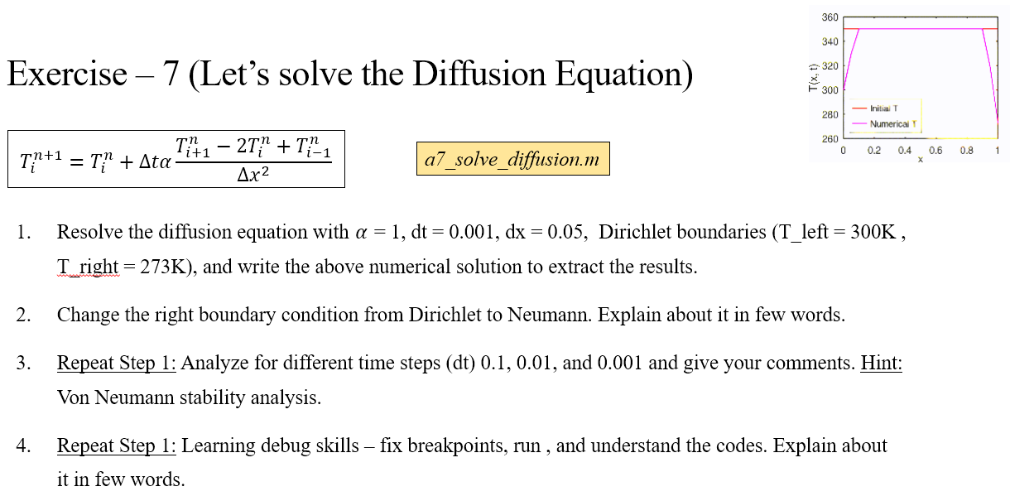
Quick Recap
Notes:
https://ezgif.com/maker
Dirichlet boundary conditions assume the solution to the variable.
In Neumann boundary conditions, a solution is assumed for the derivative of the variable.
https://en.wikipedia.org/wiki/Von_Neumann_stability_analysis

Slide 3
Contents
OpenFOAM: Numerical Solution to Diffusion Equation
Project – 1 in OpenFOAM

Slide 4
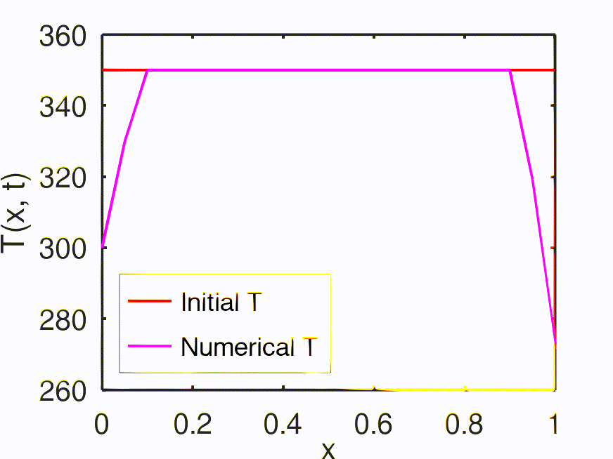
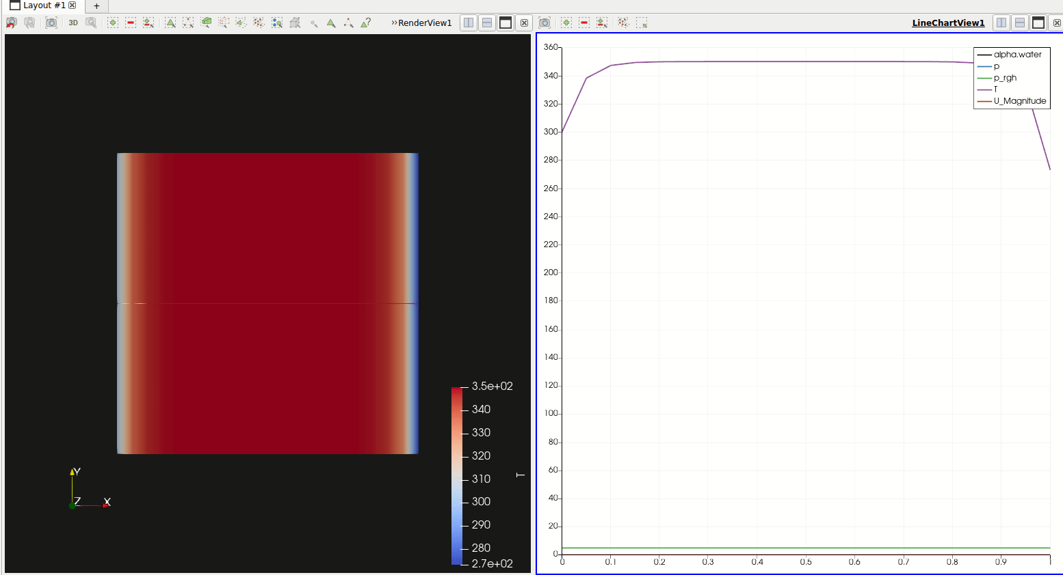
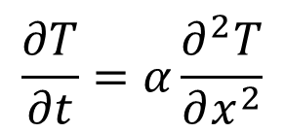
OpenFOAM: Diffusion Equation
Paraview – Post Processing tool in OpenFOAM
$$\frac{∂T}{∂t}=α\frac{∂^{2}T}{∂x^{2}}$$

Slide 5
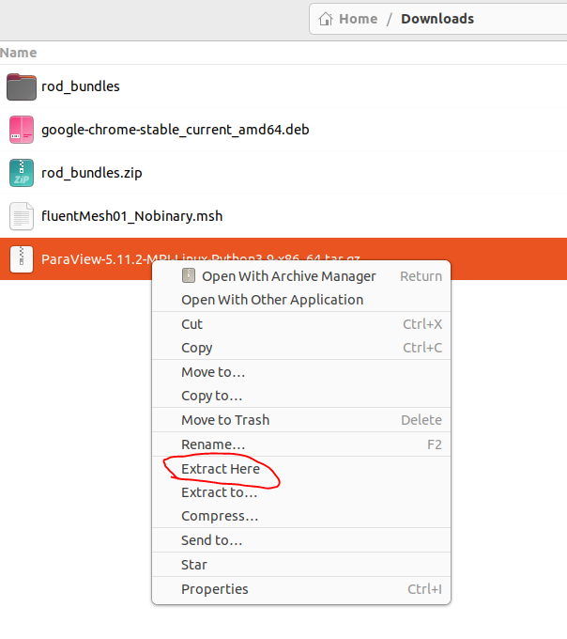
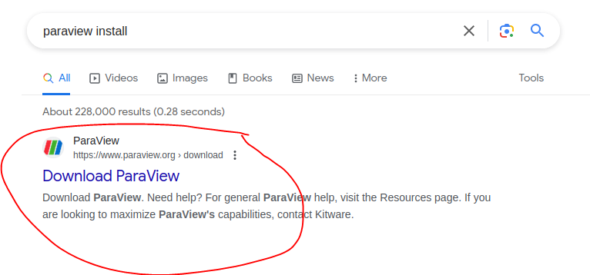
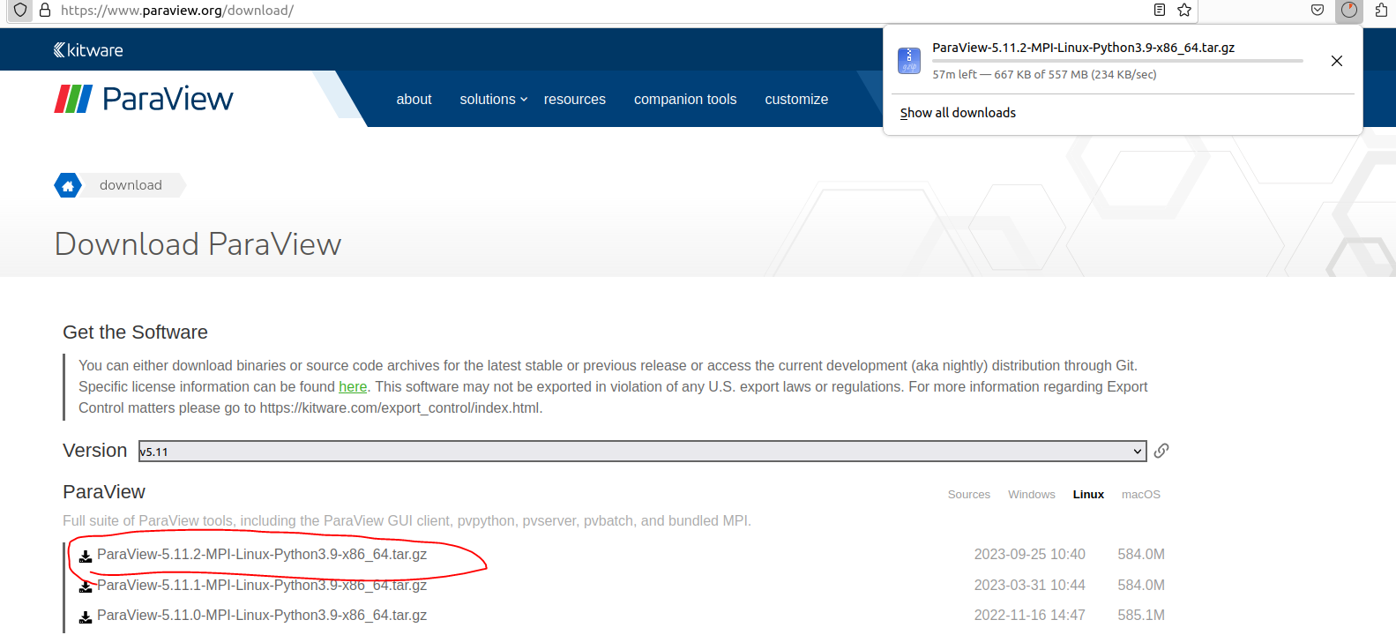
Install “ParaView”
3
1
2

Slide 6
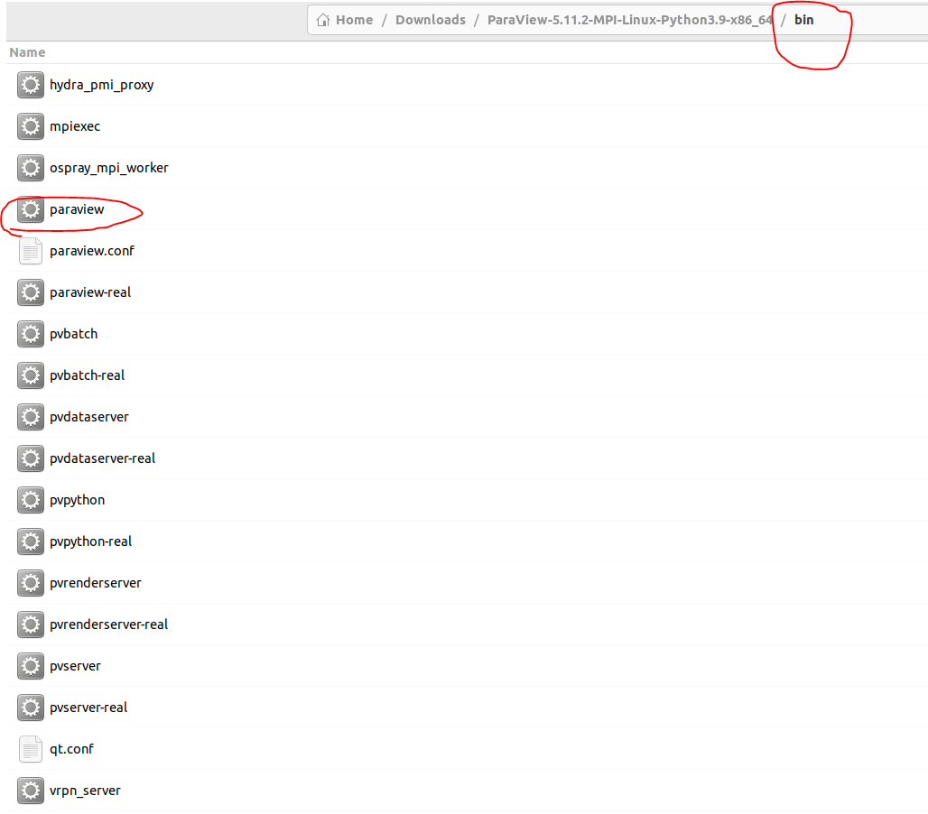
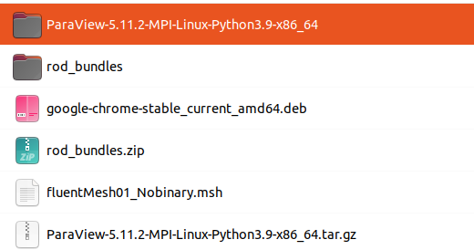
Install “ParaView”
5
Double click “paraview”
4

Slide 7
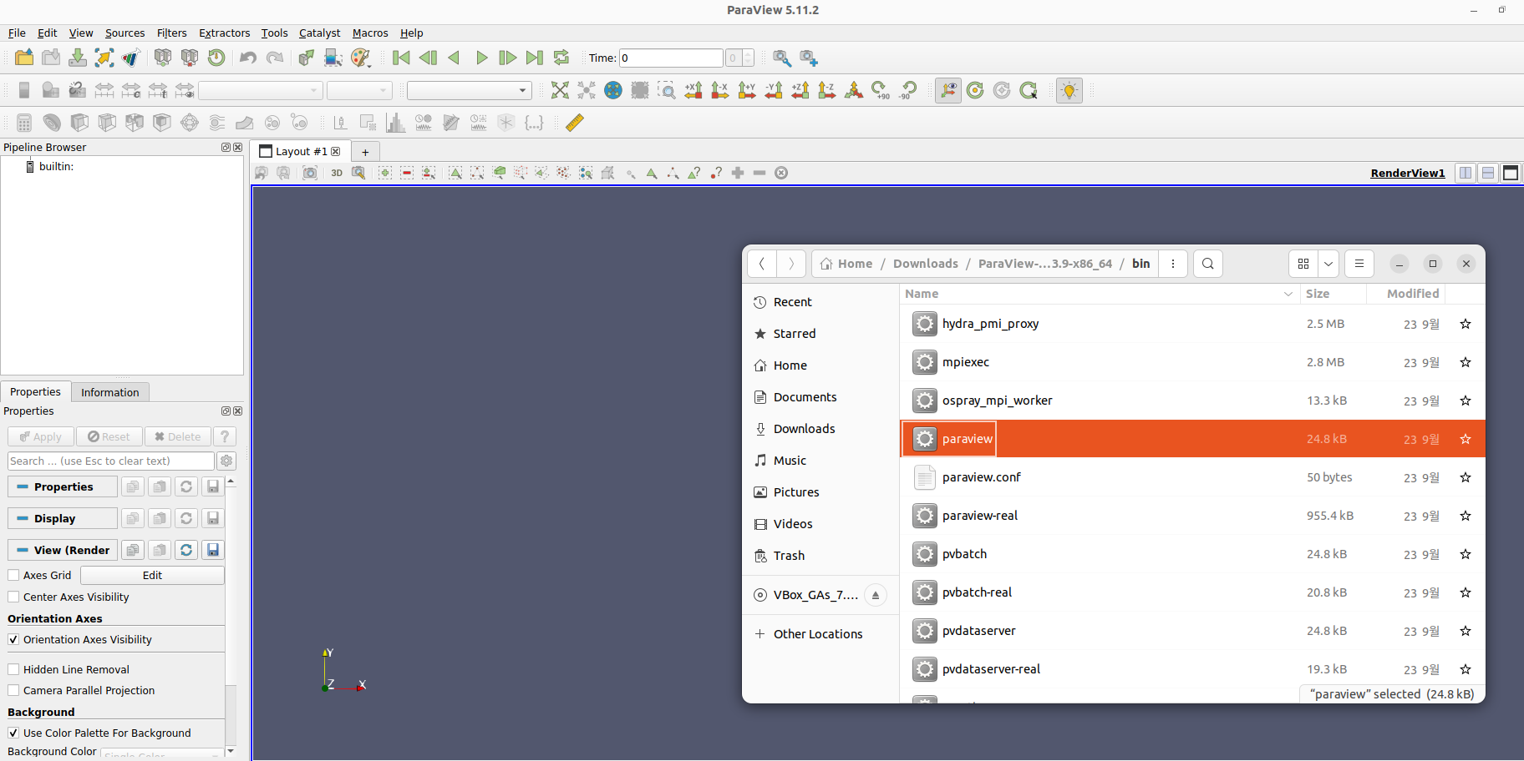
Open “ParaView”
Used for post-processing your results

Slide 8
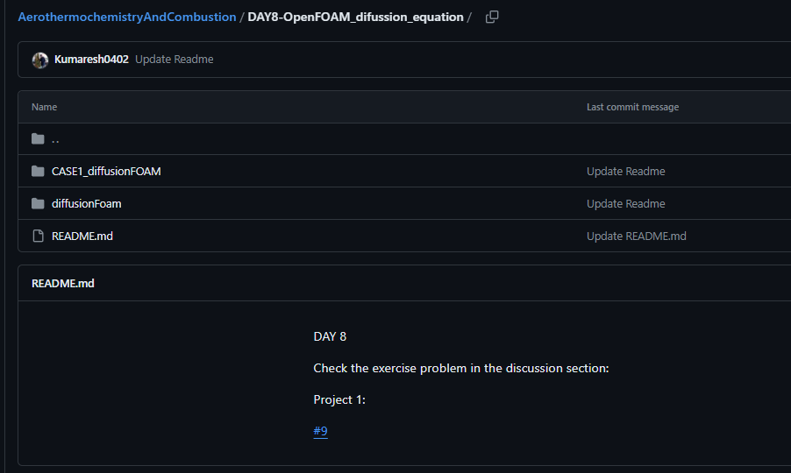
Extract files from GitHub

Slide 9
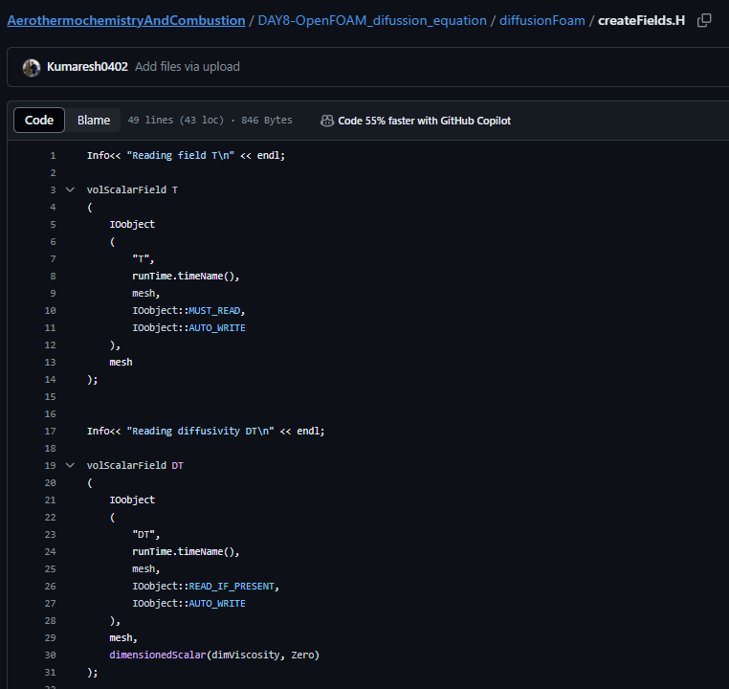
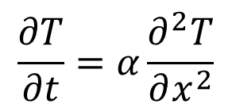
solver file ➔ diffusionFoam/createFields.H
$$\frac{∂T}{∂t}=α\frac{∂^{2}T}{∂x^{2}}$$
Temperature “T” field is created
Diffusivity as a field created

Slide 10
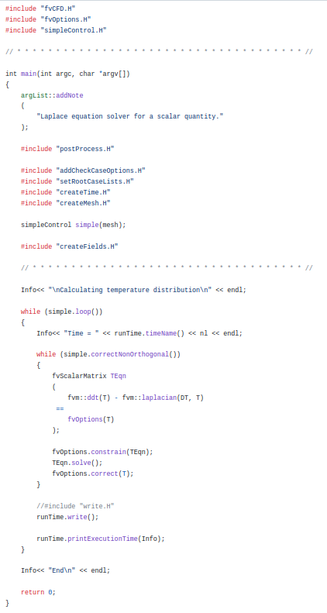
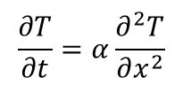
solver file ➔ diffusionFoam/diffusionFoam.C
Necessary “header” files
Matrix is created to solve “FVM”
$$\frac{∂T}{∂t}=α\frac{∂^{2}T}{∂x^{2}}$$

Slide 11
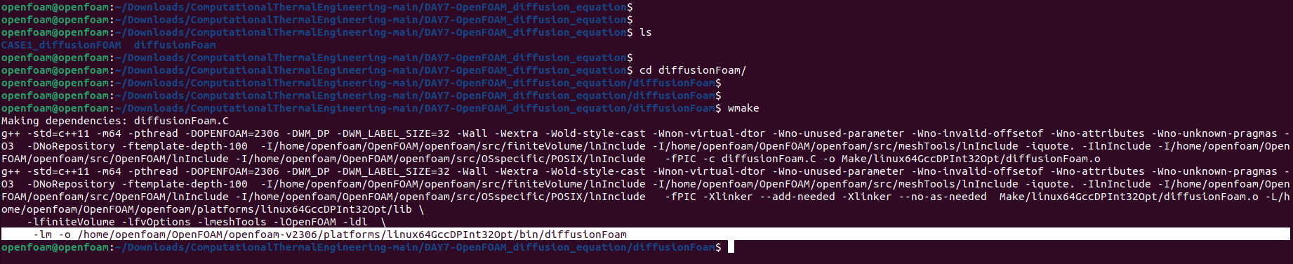
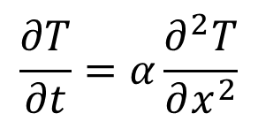
Compile diffusionFoam “solver”
$$\frac{∂T}{∂t}=α\frac{∂^{2}T}{∂x^{2}}$$
Compiled “diffusionFoam“ solver

Slide 12
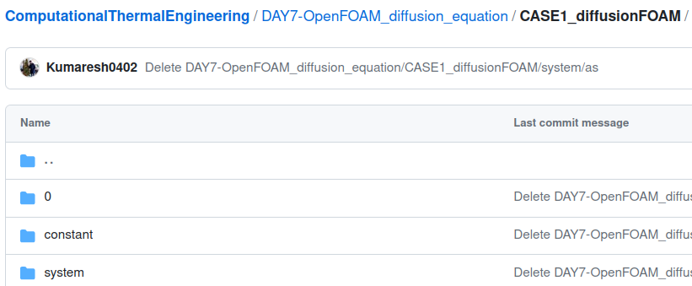
case file
$$\frac{∂T}{∂t}=α\frac{∂^{2}T}{∂x^{2}}$$
Initial conditions
Properties
Mesh, schemes, solvers, algorithm controls and tolerances for the implicit solvers.

Slide 13
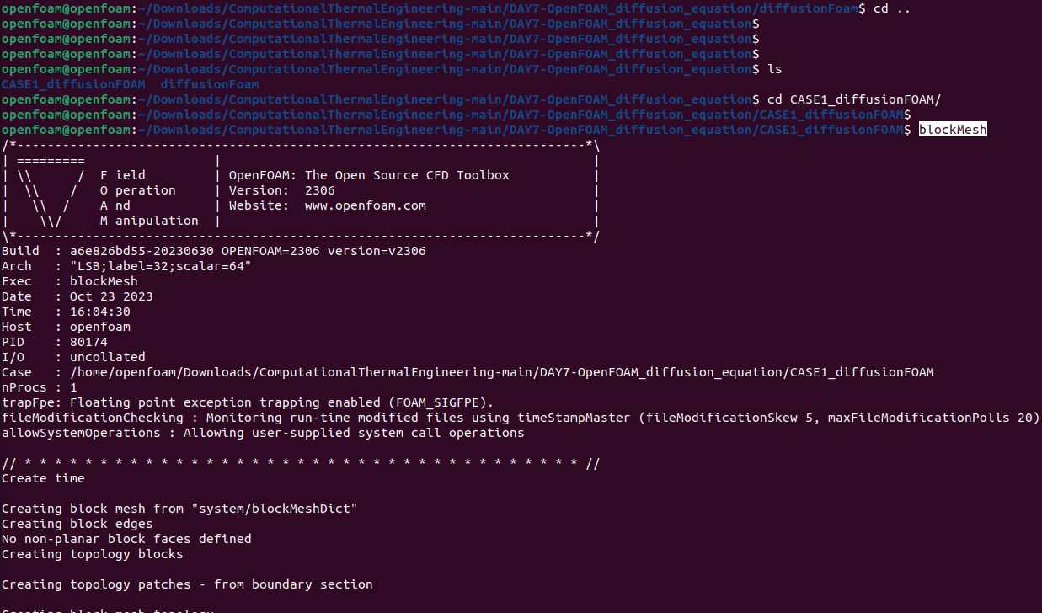
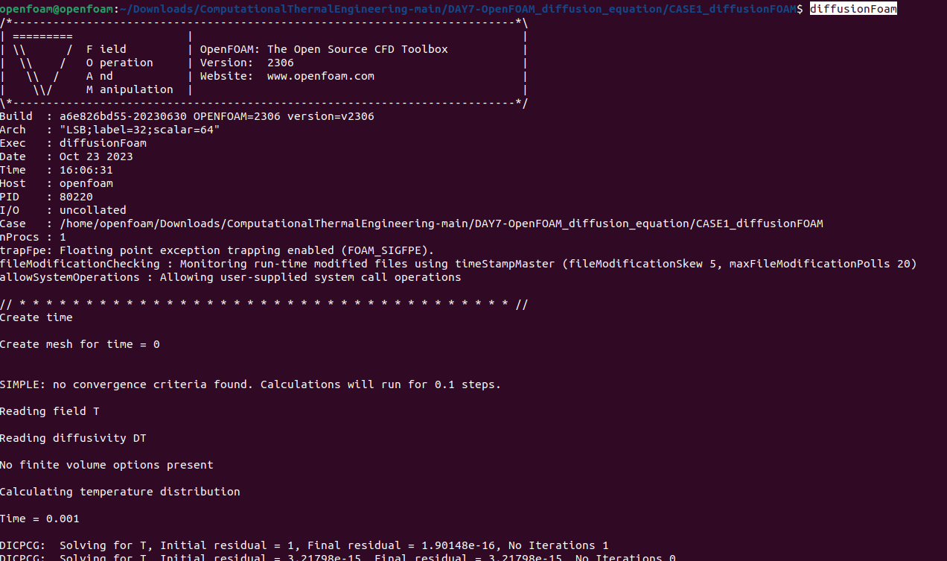
Compile the “case” file named – CASE1_diffusionFOAM
2
1

Slide 14
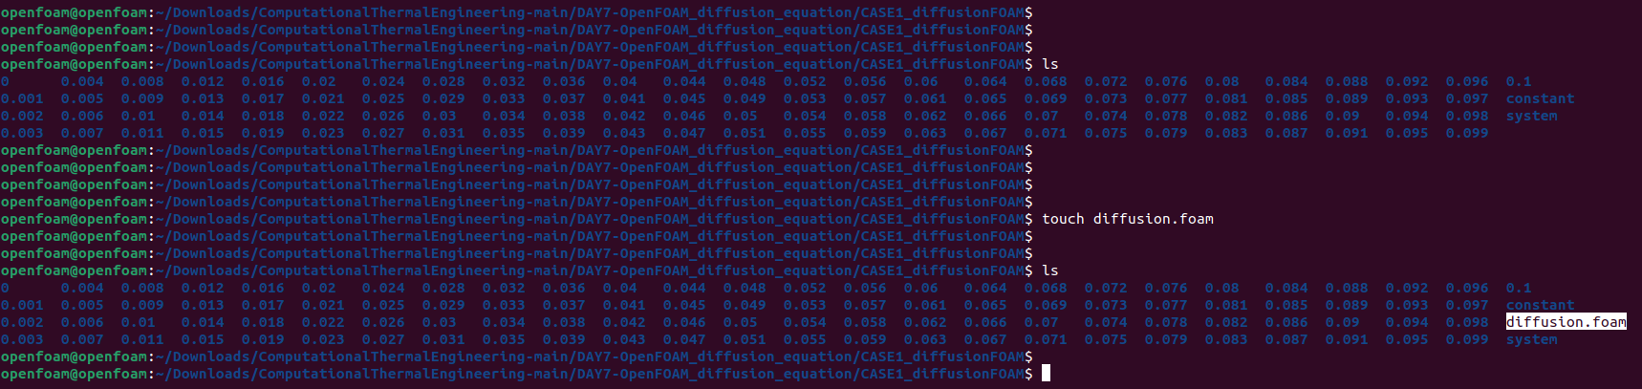
Compile the “case” file named – CASE1_diffusionFOAM
3

Slide 15
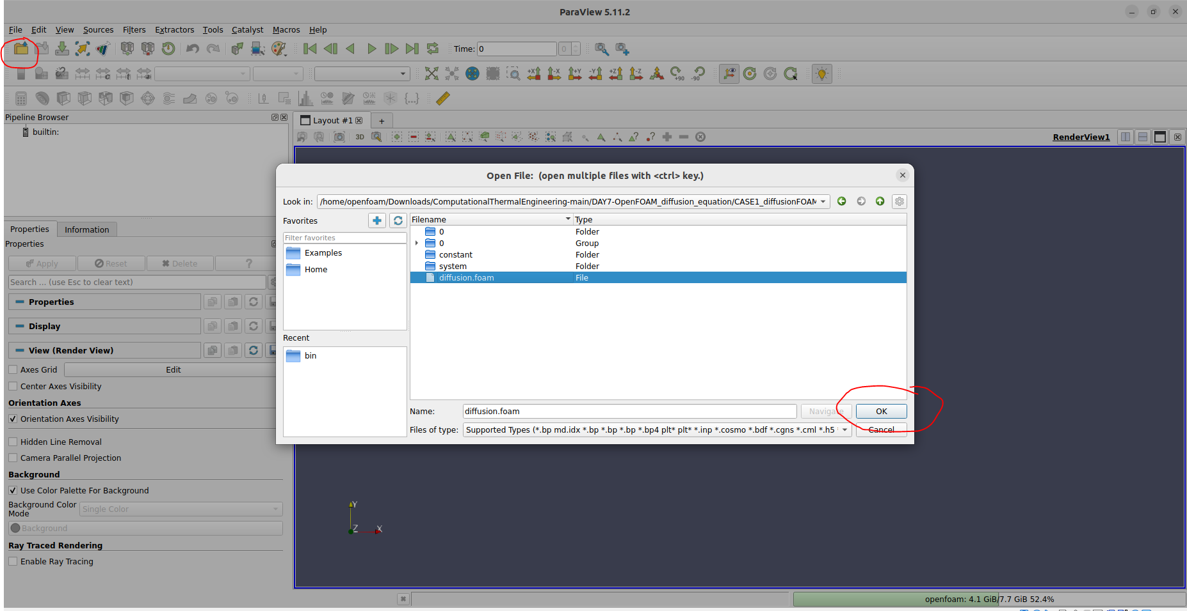
Open the “case” in paraview
4

Slide 16
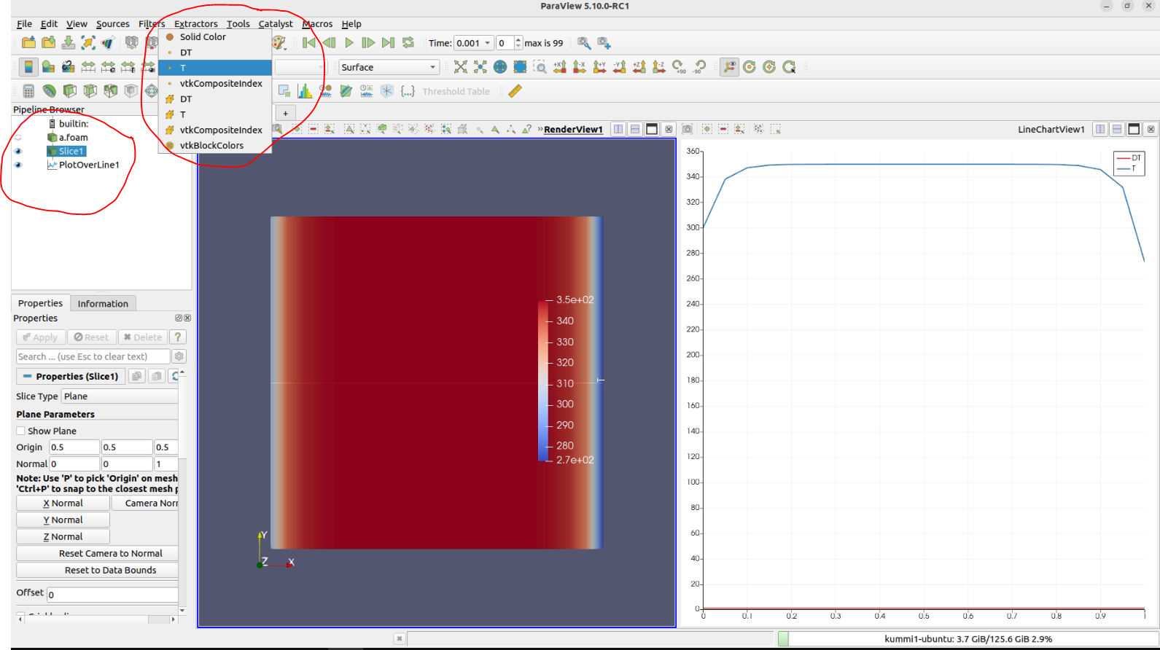
OpenFOAM: Diffusion Equation
Paraview – Post Processing tool in OpenFOAM

Slide 18
Research Project Presentation (DAY 9)
May 13:
Every individual should present the topic in the form of presentation for 15 minutes. This topic carries high marks. Please prepare and present it carefully.
Query session: 5 minutes.
Every individual should ask a single question during the presentation.

